Slide 1




PAMPANGA STATE UNIVERSITY
(former Don Honorio Ventura State University)
COLLEGE OF COMPUTING STUDIES
CAPSTONE TITLE:
The Software Development
Final Defense

Slide 2





GROUP-CODE
MEMBERS
NAME 1
NAME 2
NAME 3
NAME 4
NAME 5
NAME 6
RESPONSIBILITIES
NAME 1
NAME 2
NAME 3
NAME 4
NAME 5
NAME 6
ADVISER NAME
Final Defense

Slide 3
INTRODUCTION
Example:
Information technology has immensely developed that people nowadays are able to live their lives better which is truly different from the way they lived before. Computers have important roles in the evolution of information technology. Before, if people want to send a message, they have no choice but to send it through snail mails. Today, with the support of computers, they are able to send and receive electronic mails with just a click of a button. Information technology is developing fast and is being integrated in personal computers, smartphones, and programmable hardware.
The advances in communication combined with the evolution of the IT industry has made it possible for people to do business throughout the world in real time. Improvements in information technology also improve people’s lifestyles and business by allowing computers to reduce complications and enrich possibilities. In this time and age where everything can be made possible with the support of computers and information technology, organizations, businesses, non-profit institutions, education and research have become more accessible and systematic contributing largely to the increase of productivity and sustainability.
Final Defense

Slide 4
Final Defense
PURPOSE AND DESCRIPTION
Example:
The project was conducted in order to assist the human resource personnel and staff in their daily transaction in the Human Resource department of X University by developing a software called Human Resource Information System. Human Resource Information System is capable of automating application, storing data, and monitoring reports.
Human Resource Information System has the following capabilities:
1 Applicant login. This allows applicant user of the system to log-in as a guess and fill up the data from HRD form 02-A (application form), save it to database and print application form.
2 HR Login. HR Staff account is designed to create new accounts for new potential employees of X University. Once hired, HR staff will be capable of syncing data from application form to employee personal information by enabling them to update employee information and view reports under administrator user access permission.
3 Employee Login. Once a new employee account is created, the user of the system will ask the new user if he/she wants to sync information of his/her application to personal information. Employee accounts can be viewed and updated by the administrator user (access permission) and employees can print personal information form.
4 Admin Login. Administrator account log in is authorized to access all the modules in the system including the master file setup, to manipulate system accounts, and to view all the reports.

Slide 5
OBJECTIVE OF THE STUDY
For example:
The main objective of the study is to assist the X University in the monitoring, storing, manipulating, retrieving and distributing information to the employee. Specifically it aims to:
1. Design and develop a web-based system called X University HRIS which is capable of:
A. Providing an efficient software with authentication and account management features that allow the system admin to manipulate user accounts, user access, and the end users to log in and change their password.
Final Defense

Slide 6
OBJECTIVE OF THE STUDY
A. Providing a monitoring system that is integrated into a database and reporting tool which will allow HR staff and administrator to monitor and print the following HR reports:
Applicant application
Applicant essay form
Employee’s personal information
Number of employees per department
List of employees who possess masters and doctor’s degree
Employee’s year in service
List of employees who will retire
List of employee’s birthdays per month
Employee’s dependent benefits
Employee’s contact person
Education per department
Audit trail log reports
Evaluate the HRIS software in order to determine if it complies with the ISO 9126 standards.
To prepare implementation plan for the deployment of the HRIS Software.
Final Defense

Slide 7

SCOPE AND LIMITATION
The Scope and Delimitation of the Study should include brief statement of the general purpose of the study, target users/beneficiaries of the study, the period of the study features of the proposed software.
The Limitation of the study includes the weakness of the study beyond the control of the researchers. This section may be not be included in the study if there is no such weaknesses of the study beyond the control of the researcher.
Final Defense

Slide 8
RESEARCH METHODOLOGY
Final Defense

Slide 9
SOFTWARE METHODOLOGY
Final Defense

Slide 10

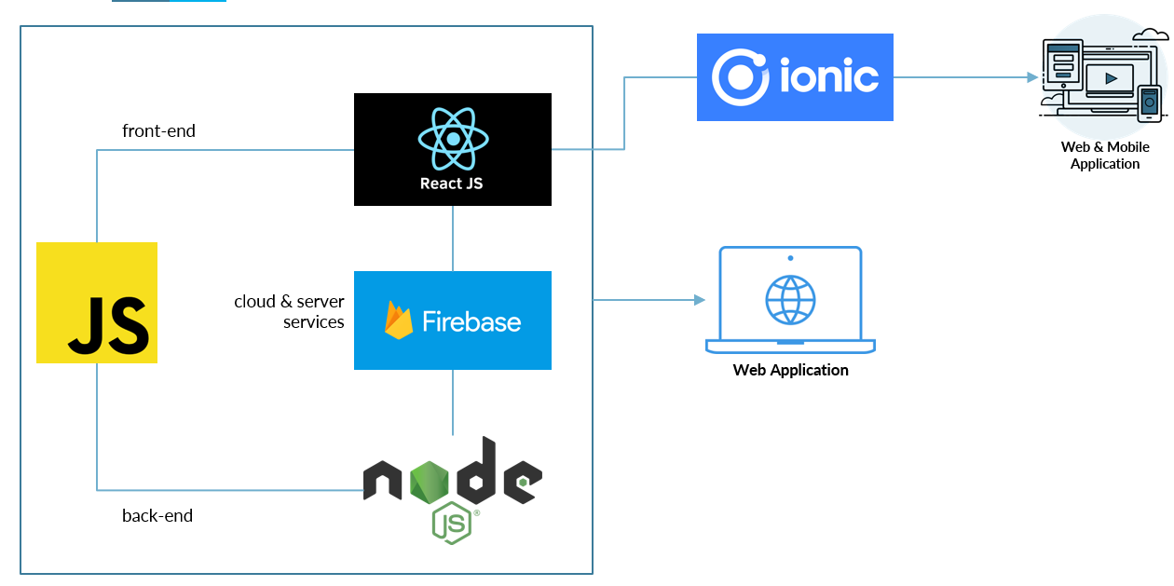
WORK PLAN
Final Defense

Slide 11
RESULT AND DISCUSSIONS
Final Defense

Slide 12
RECOMMENDATION
Final Defense

Slide 13


Software SS
NOTE:
FOR SYSTEM DEVELOPMENT INSERT SAMPLE DIAGRAMS, FIGURES,
FOR GAME DEVELOPMENT INSERT STORYBOARD
Final Defense

Slide 14

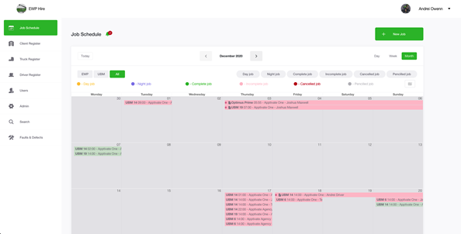
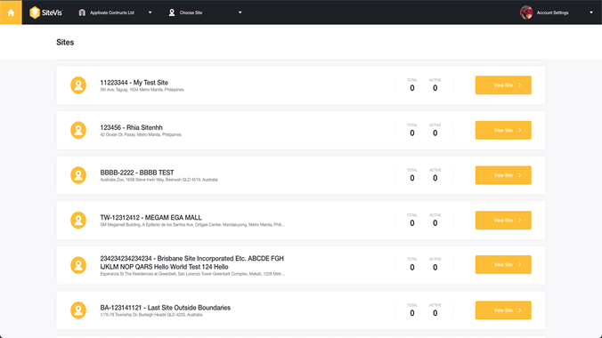
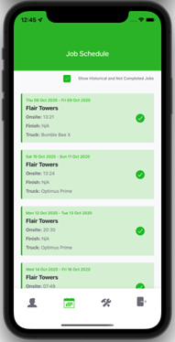
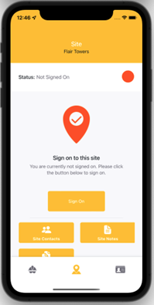
SS1
SS2
Final Defense

Slide 15

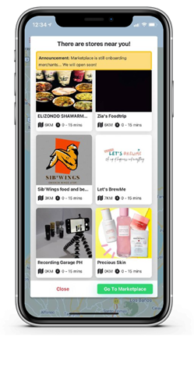
SS
The delivery that saves you money,
and Mother Earth.
an on-demand delivery app that provides affordable and eco-friendly delivery services on bicycles – helping individuals, small businesses and the world we live in.
Final Defense

Slide 16

EXAMPLE EVIDENCES
Final Defense

Slide 17
INSERT IMAGE
Final Defense

Slide 18

QUESTION AND ANSWER
Got any questions?

Slide 19

PAMPANGA STATE UNIVERSITY
(former Don Honorio Ventura State University)
COLLEGE OF COMPUTING STUDIES
Thank You
For Your Attention

